Slide 1
Final Project
Dataset – “athlete_events.csv”
120 years of Olympic history: athletes and results
Team Members: Dan Burke, Marley Akonnor, and Rajinder Singh

Slide 2
Dataset - str(Olympics)
data.frame’: 271116 obs. of 15 variables:
$ ID : int 16 17 17 17 17 17 20 20 20 20 ...
$ Name : chr "Juhamatti Tapio Aaltonen" "Paavo Johannes Aaltonen" "Paavo Johannes Aaltonen" "Paavo Johannes Aaltonen" ...
$ Sex : chr "M" "M" "M" "M" ...
$ Age : int 28 28 28 28 28 32 20 20 22 22 ...
$ Height: int 184 175 175 175 175 175 176 176 176 176 ...
$ Weight: num 85 64 64 64 64 64 85 85 85 85 ...
$ Team : chr "Finland" "Finland" "Finland" "Finland" ...
$ NOC : chr "FIN" "FIN" "FIN" "FIN" ...
$ Games : chr "2014 Winter" "1948 Summer" "1948 Summer" "1948 Summer" ...
$ Year : int 2014 1948 1948 1948 1948 1952 1992 1992 1994 1994 ...
$ Season: chr "Winter" "Summer" "Summer" "Summer" ...
$ City : chr "Sochi" "London" "London" "London" ...
$ Sport : chr "Ice Hockey" "Gymnastics" "Gymnastics" "Gymnastics" ...
$ Event : chr "Ice Hockey Men's Ice Hockey" "Gymnastics Men's Individual All-Around" "Gymnastics Men's Team All-Around" "Gymnastics Men's Horse Vault" ...
$ Medal : chr "Bronze" "Bronze" "Gold" "Gold" ...
- attr(*, "na.action")= 'omit' Named int [1:240935] 1 2 3 4 5 6 7 8 9 10 ...
..- attr(*, "names")= chr [1:240935] "1" "2" "3" "4" ...
After data cleaning:
Observations – 30,181
Variables - 15
Sex:
Female – 34%
Male – 66%
Unique Sport - 55
Question:
Can the type of Sport be predicted based on a set of variables?

Slide 3
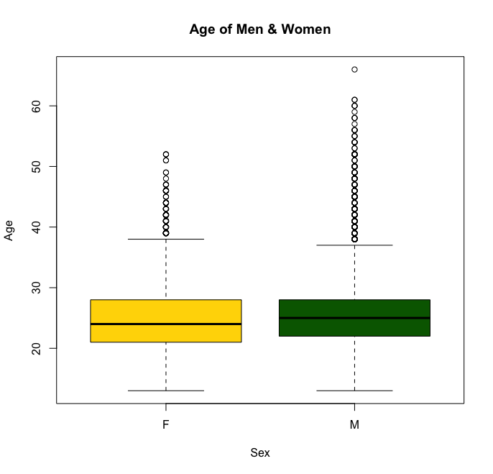
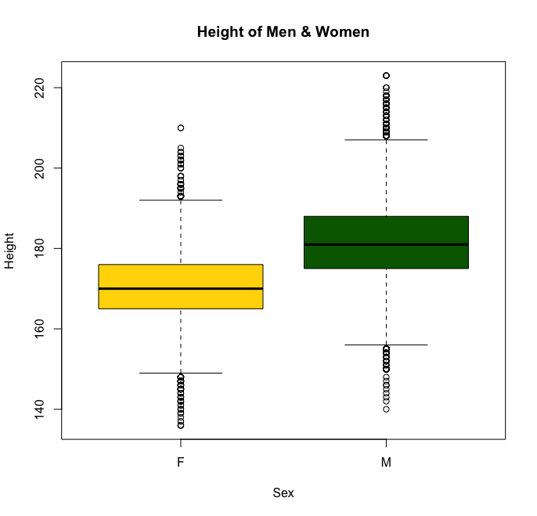
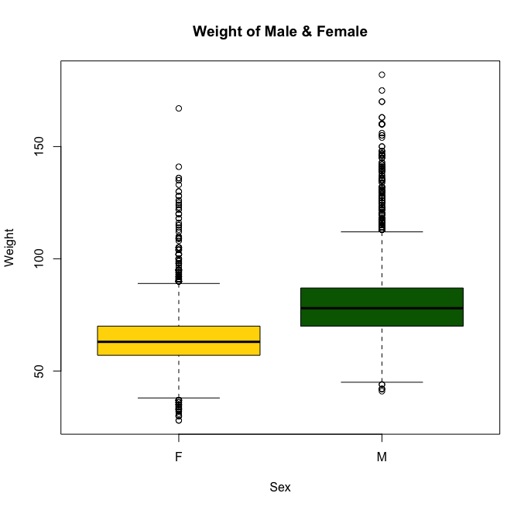
Boxplot – comparing Male/Female, Age, Height, and Weight
Age of Men & Women
Height of Men & Women
Weight of Men & Women
The mean of Men’s and Women’s age is almost similar, but the mean for
Men's height and weight is higher than women

Slide 4
randomForest Analysis – Men dataset with all variables to predict Sport
52 different Sport
Call:
randomForest(x = results.men[, -13], y = results.men[, 13])
Type of random forest: classification
Number of trees: 500
No. of variables tried at each split: 3
OOB estimate of error rate: 2.77%
class.error
Alpline Skiing 0.000000000
Athletics 0.000000000
Basketball 0.014754098
Boxing 0.042335766
Cycling 0.026905830
Equestrianism 0.029723992
Fencing 0.012771392
Gymnastics 0.012251149
Ice Hockey 0.000000000
Judo 0.085798817
Swimming 0.005307051
Table Tennis 0.144578313
Weightlifting 0.025761124
Wresting 0.001112347
Mean Decrease Gini
ID 755.7982
Name 767.4244
Sex 0.0000
Age 870.5428
Height 1252.0440
Weight 1417.6302
Team 1080.1127
NOC 1080.0599
Games 658.4820
Year 622.6473
Season 700.0498
City 450.0372
Event 8809.4651
Medal 320.1673
Observations – 19,831
Variables - 15
$ Sport : chr "Ice Hockey" "Gymnastics" "Gymnastics" "Gymnastics" ...
$ Event : chr "Ice Hockey Men's Ice Hockey" "Gymnastics Men's Individual All-Around" "Gymnastics Men's Team All-Around" "Gymnastics Men's Horse Vault" ...

Slide 5
randomForest Analysis – Men dataset with all variables (except Event) to predict Sport
52 different Sport
Call:
randomForest(x = results1.men[, -13], y = results1.men[, 13])
Type of random forest: classification
Number of trees: 500
No. of variables tried at each split: 3
OOB estimate of error rate: 33.28%
class.error
Alpline Skiing 0.32758621
Athletics 0.24616023
Basketball 0.30655738
Boxing 0.63941606
Cycling 0.51121076
Equestrianism 0.29087049
Fencing 0.40102171
Gymnastics 0.14701378
Ice Hockey 0.02897103
Judo 0.81952663
Swimming 0.18119788
Table Tennis 0.39759036
Weightlifting 0.38407494
Wresting 0.48832036
Mean Decrease Gini
ID 1891.3999
Name 1917.0809
Sex 0.0000
Age 1658.8337
Height 2170.9877
Weight 2425.3163
Team 1835.0132
NOC 1812.1512
Games 1186.3730
Year 1153.3815
Season 597.2168
City 881.8638
Medal 778.9835
Observations – 19,831
Variables - 14

Slide 6
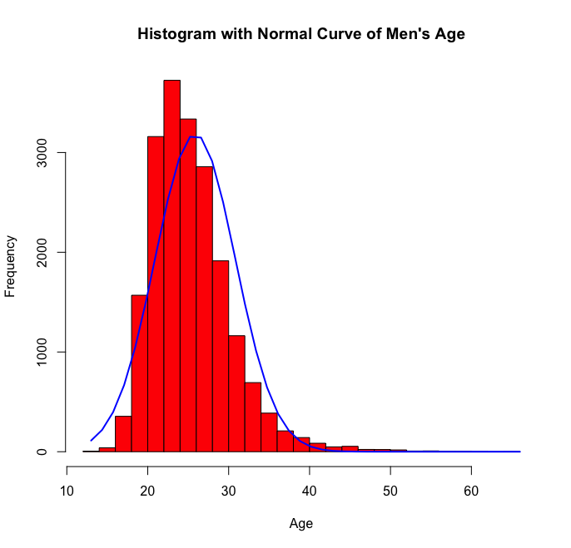
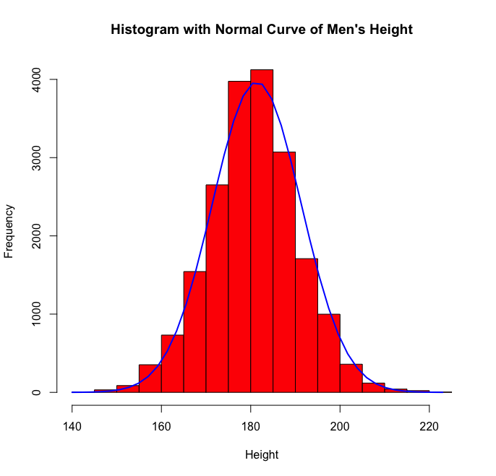
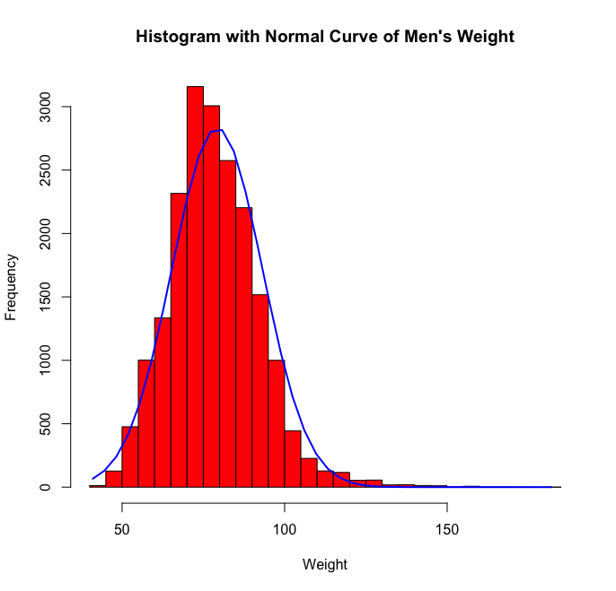
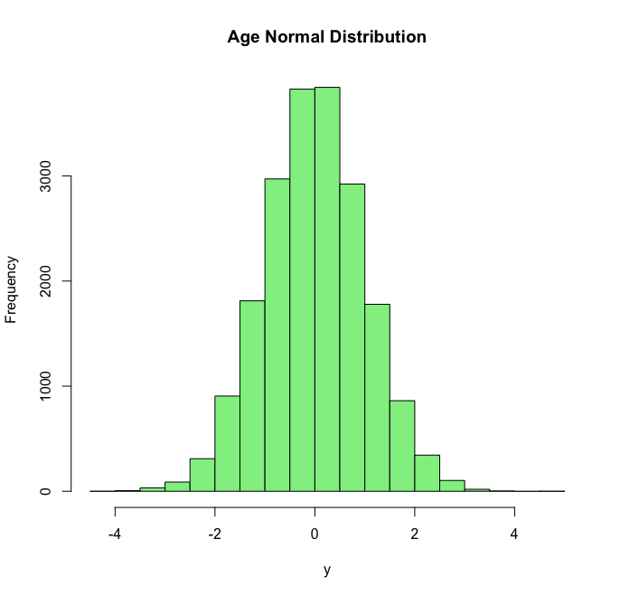
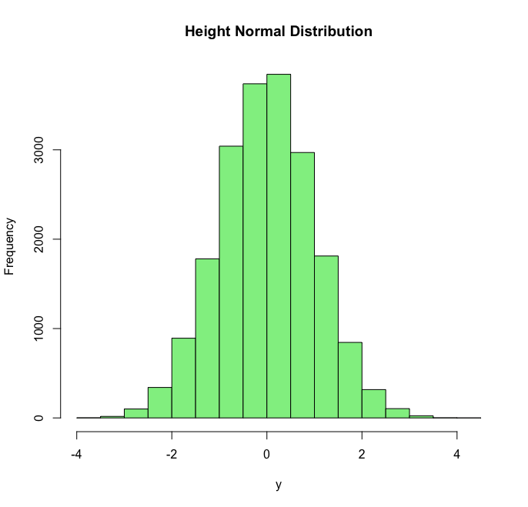
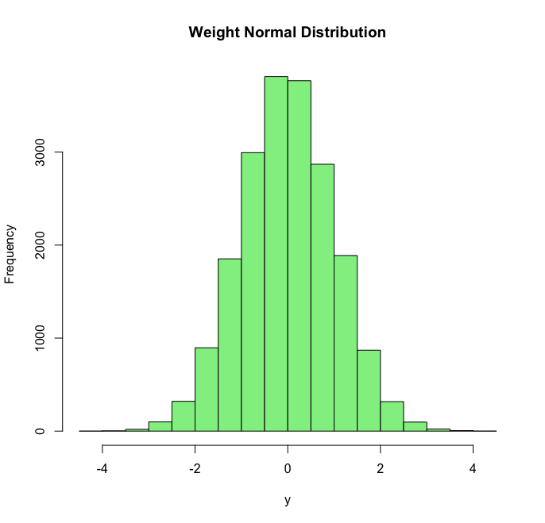
Histogram – Male, Age, Height, and Weight distribution
Age
Height
Weight
Average SD
25.862942 4.969973
Average SD
181.352831 9.9707143
Average SD
79.25132 13.96353
Age
Height
Weight
96% of values within 2 Standard Deviation of the mean
95% of values within 2 Standard Deviation of the mean
96% of values within 2 Standard Deviation of the mean

Slide 7
randomForest Analysis – Men dataset with Age, Height & Weight variables to predict Sport
52 different Sport
Call:
randomForest(x = results2.men[, -4], y = results2.men[, 4])
Type of random forest: classification
Number of trees: 500
No. of variables tried at each split: 1
OOB estimate of error rate: 70.94%
class.error
Alpline Skiing 0.9310345
Athletics 0.3565795
Basketball 0.6688525
Boxing 0.7824818
Cycling 0.9626308
Equestrianism 0.5116773
Fencing 0.8365262
Gymnastics 0.2986217
Ice Hockey 0.5244755
Judo 0.9704142
Swimming 0.4397272
Table Tennis 0.9759036
Weightlifting 0.5081967
Wresting 0.7274750
Mean Decrease Gini
Age 1586.296
Height 2129.205
Weight 2245.461
Observations – 19,831
Variables - 4

Slide 8
randomForest Analysis – Men dataset with Age, Height & Weight variables and selected sports to predict Sport
Call:
randomForest(x = olympics.combine1[, -4], y = olympics.combine1[, 4])
Type of random forest: classification
Number of trees: 500
No. of variables tried at each split: 1
OOB estimate of error rate: 27.16%
class.error
Athletics 0.2288925
Equestrianism 0.4374057
Gymnastics 0.2592593
Swimming 0.2783588
Weightlifting 0.3533835
Mean Decrease Gini
Age 1347.559
Height 1234.591
Weight 1110.640
Observations – 8,490
Variables - 4
# Row 1000 & 4000
> olympics.combine1[1000,]
Age Height Weight Sport
244057 26 164 59 Gymnastics
> olympics.combine1[4000,]
Age Height Weight Sport
197817 34 181 109 Weightlifting
> #Predicting Row 1000 & 4000
> predict(olympics.combine1.rf, olympics.combine1[1000,-5])
244057
Gymnastics
Levels: Athletics Equestrianism Gymnastics Swimming Weightlifting
> predict(olympics.combine1.rf, olympics.combine1[4000,-5])
197817
Weightlifting
Levels: Athletics Equestrianism Gymnastics Swimming Weightlifting
> # Perdicting for Age = 30, Height = 170, Weight = 50
> predict(olympics.combine1.rf, c(30, 170, 50))
1
Athletics
Levels: Athletics Equestrianism Gymnastics Swimming Weightlifting

Slide 9
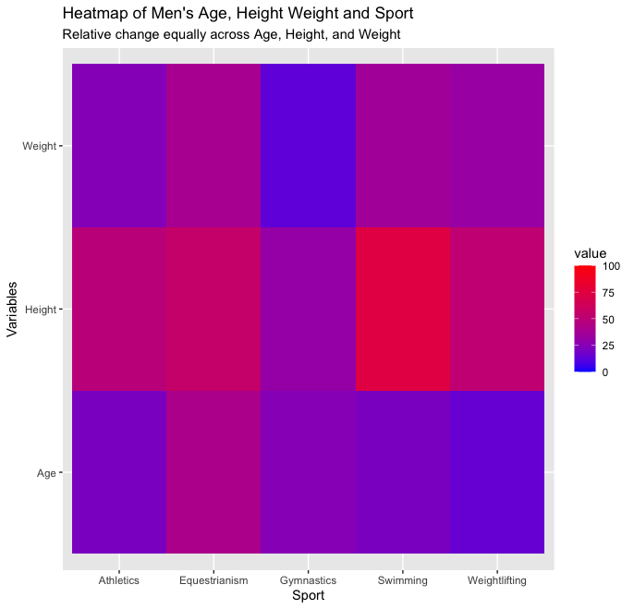
Mean Decrease Gini
Age 1586.296
Height 2129.205
Weight 2245.461
Height is an important
variable

Slide 10
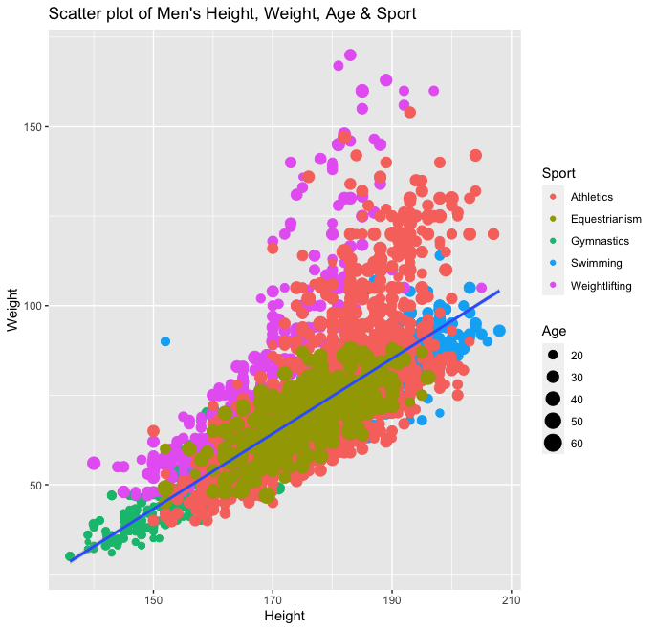
Athletics, Equestrianism, Gymnastics, and Swimming dataset close to the abline
Call:
randomForest(x = olympics.combine1[, -4], y = olympics.combine1[, 4])
Type of random forest: classification
Number of trees: 500
No. of variables tried at each split: 1
OOB estimate of error rate: 27.16%
Mean Decrease Gini
Age 1347.559
Height 1234.591
Weight 1110.640
Confusion matrix:
Athletics Equestrianism Gymnastics Swimming Weightlifting class.error
Athletics 2813 50 158 553 74 0.2288925
Equestrianism 251 (38%) 373 15 19 5 0.4374057
Gymnastics 214 (18%) 8 860 64 15 0.2592593
Swimming 627 (25%) 5 54 1794 6 0.2783588
Weightlifting 103 (19%) 6 56 23 344 0.3533835

Slide 11
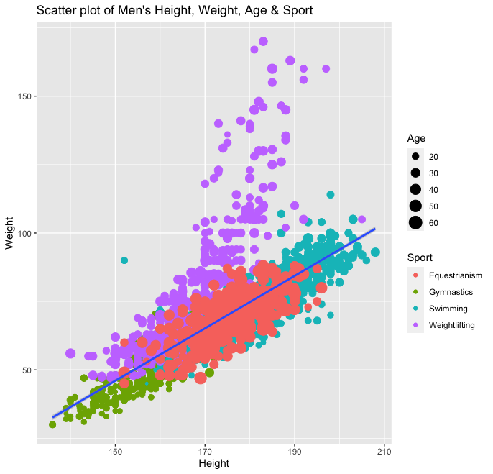
Equestrianism, Gymnastics, and Swimming dataset close to the abline
Call:
randomForest(x = olympics.combine4[, -4], y = olympics.combine4[, 4])
Type of random forest: classification
Number of trees: 500
No. of variables tried at each split: 1
OOB estimate of error rate: 11.44%
Mean Decrease Gini
Age 828.1624
Height 940.8668
Weight 822.1528
Confusion matrix:
Equestrianism Gymnastics Swimming Weightlifting class.error
Equestrianism 522 43 91 7 0.21266968
Gymnastics 26 1003 112 20 0.13608958
Swimming 33 94 2345 14 0.05671762
Weightlifting 17 663 34 418 0.21428571

Slide 12
randomForest Analysis – Men dataset (Train & Test) with Age, Height & Weight variables and selected sports to predict Sport
Call:
randomForest(x = olympics.combine4.Train[, -4], y = olympics.combine4.Train[, 4])
Type of random forest: classification
Number of trees: 500
No. of variables tried at each split: 1
OOB estimate of error rate: 12.45%
class.error
Equestrianism 0.23595506
Gymnastics 0.15454545
Swimming 0.05475331
Weightlifting 0.24250681
Mean Decrease Gini
Age 579.5796
Height 641.9452
Weight 550.3363
Observations – 3,244
Variables - 4
# Row 500 & 1300
olympics.combine4.Test[500,]
Age Height Weight Sport
44714 22 196 88 Swimming
olympics.combine4.Test[1300,]
Age Height Weight Sport
160592 28 154 58 Weightlifting
> #Predicting Row 500 & 1300
> predict(olympics.combine4.Train.rf, olympics.combine4.Test[500,-4]) 44714
Swimming
Levels: Equestrianism Gymnastics Swimming Weightlifting
> predict(olympics.combine4.Train.rf, olympics.combine4.Test[1300,-4]) 160592
Weightlifting
Levels: Equestrianism Gymnastics Swimming Weightlifting
> # Perdicting for Age = 30, Height = 170, Weight = 50
predict(olympics.combine4.Train.rf, c(30, 170, 50))
1
Equestrianism
Levels: Equestrianism Gymnastics Swimming Weightlifting

Slide 13
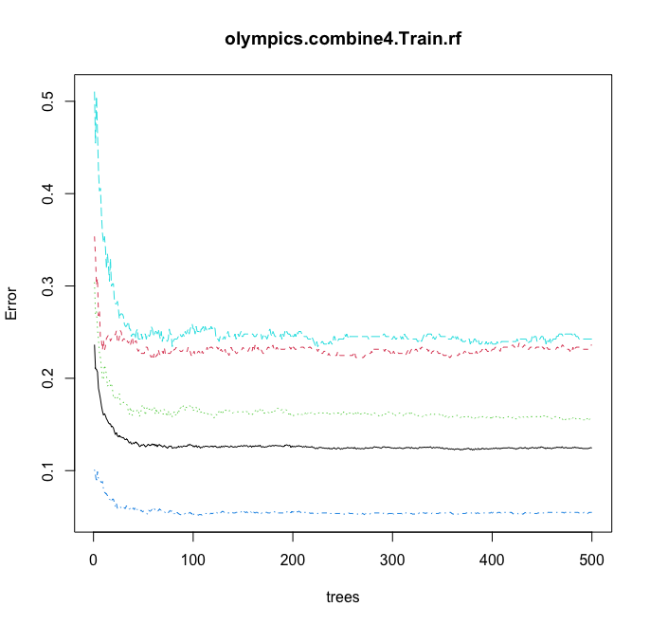
Plot() on random Forest model
Calling plot() on the random forest model
Will show how OOB error changes with
the number of trees in the forest.
This plot suggests that the model stabilizes
after roughly 100 trees.

Slide 14
Linear Modeling Analysis – Men dataset with Age, Height & Weight variables and selected sports to predict Sport
Call:
lm(formula = Sport1 ~ Age, data = olympics.combine4)
Residuals:
Min 1Q Median 3Q Max
-1.85905 -0.63140 0.08403 0.36860 2.33614
Coefficients:
Estimate Std. Error t value Pr(>|t|)
(Intercept) 3.940413 0.039869 98.83 <2e-16 ***
Age -0.056914 0.001623 -35.08 <2e-16 ***
Residual standard error: 0.7653 on 4840 degrees of freedom
Multiple R-squared: 0.2027,
Adjusted R-squared: 0.2025
F-statistic: 1230 on 1 and 4840 DF, p-value: < 2.2e-16
Call:
lm(formula = Sport1 ~ Height, data = olympics.combine4)
Residuals:
Min 1Q Median 3Q Max
-1.8751 -0.4427 0.2266 0.4047 1.8371
Coefficients:
Estimate Std. Error t value Pr(>|t|)
(Intercept) 0.3825325 0.1699020 2.251 0.0244 *
Height 0.0127173 0.0009736 13.063 <2e-16 ***
Residual standard error: 0.8424 on 4840 degrees of freedom
Multiple R-squared: 0.03405,
Adjusted R-squared: 0.03385
F-statistic: 170.6 on 1 and 4840 DF, p-value: < 2.2e-16
Call:
lm(formula = Sport1 ~ Weight, data = olympics.combine4)
Residuals:
Min 1Q Median 3Q Max
-1.9709 -0.3765 0.1281 0.4650 1.8415
Coefficients:
Estimate Std. Error t value Pr(>|t|)
(Intercept) 1.2272015 0.0516132 23.78 <2e-16 ***
Weight 0.0198152 0.0007284 27.20 <2e-16 ***
Residual standard error: 0.7982 on 4840 degrees of freedom
Multiple R-squared: 0.1326,
Adjusted R-squared: 0.1325
F-statistic: 740.1 on 1 and 4840 DF, p-value: < 2.2e-16
Call:
lm(formula = Sport1 ~ Age + Height + Weight, data = olympics.combine4)
Residuals:
Min 1Q Median 3Q Max
-2.12804 -0.42757 0.02107 0.33133 2.54187
Coefficients:
Estimate Std. Error t value Pr(>|t|)
(Intercept) 4.6514538 0.1619392 28.72 <2e-16 ***
Age -0.0663255 0.0014018 -47.32 <2e-16 ***
Height -0.0163120 0.0011540 -14.13 <2e-16 ***
Weight 0.0340233 0.0009179 37.06 <2e-16 ***
Residual standard error: 0.6527 on 4838 degrees of freedom
Multiple R-squared: 0.4203,
Adjusted R-squared: 0.4199
F-statistic: 1169 on 3 and 4838 DF, p-value: < 2.2e-16
Age, Height, and Weight variables accounts for 42% of the variability in Sport

Slide 15
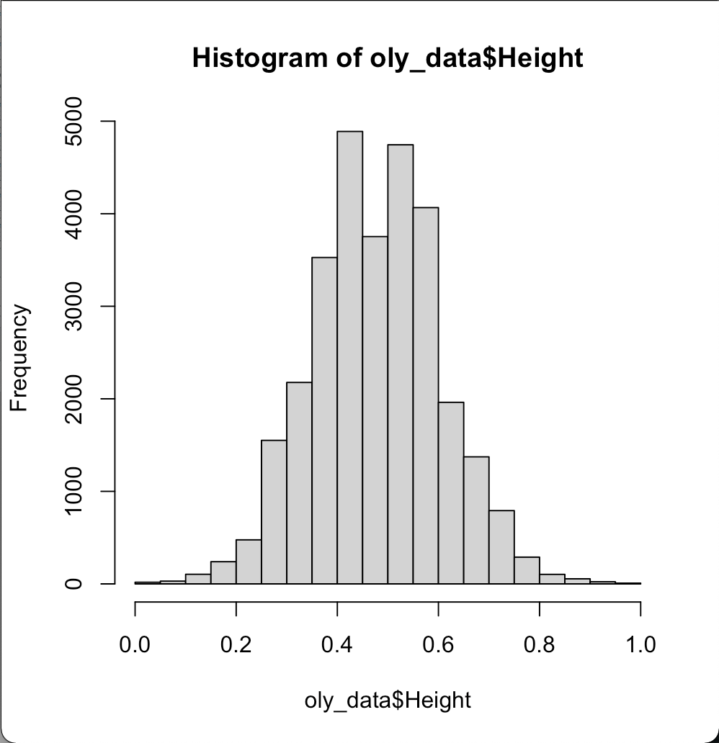
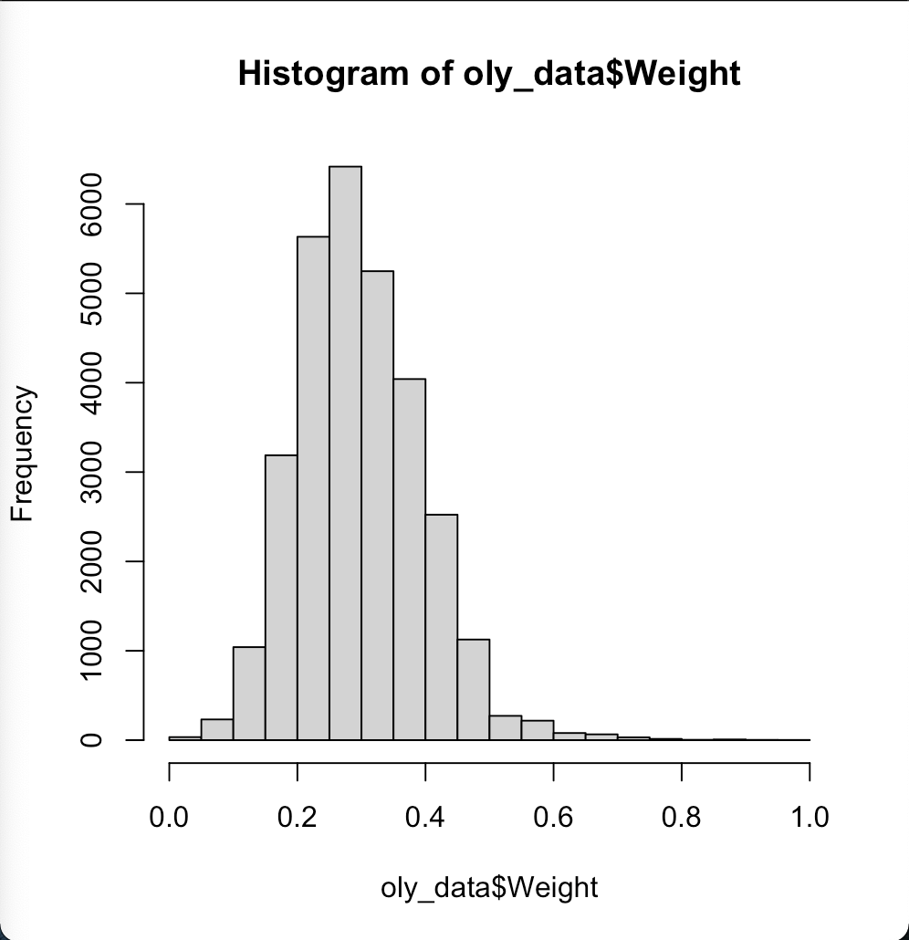
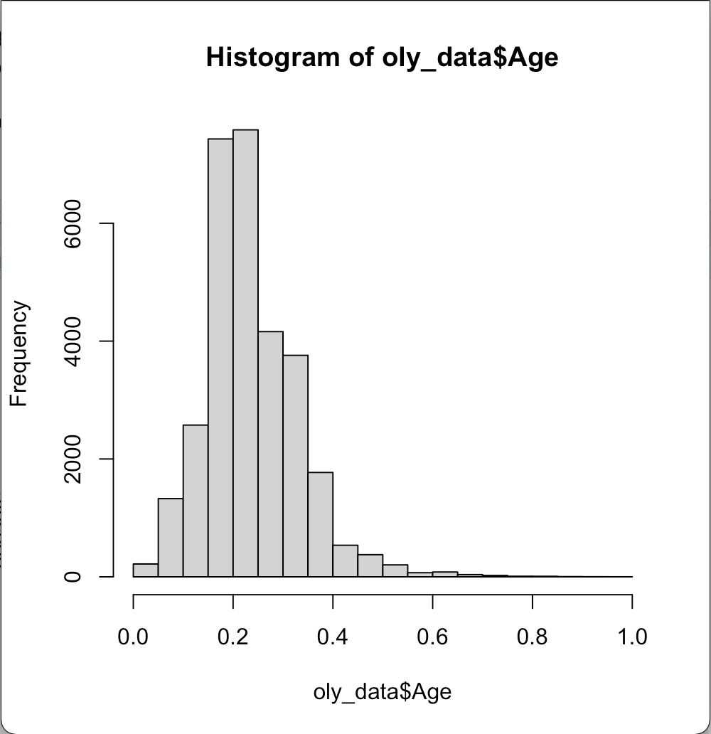
Use Min-Max normalization to prepare the data for neural network: normalize <- function(x) { return ((x - min(x)) / (max(x) - min(x))) }
Allows for easier gradient search when the neural net is running
oly_data$Age <- normalize(oly_data$Age) hist(oly_data$Age)
oly_data$Height <- normalize(oly_data$Height) hist(oly_data$Height)
oly_data$Weight <- normalize(oly_data$Weight) hist(oly_data$Weight)
Normalization confines all values to a score between 0-1

Slide 16
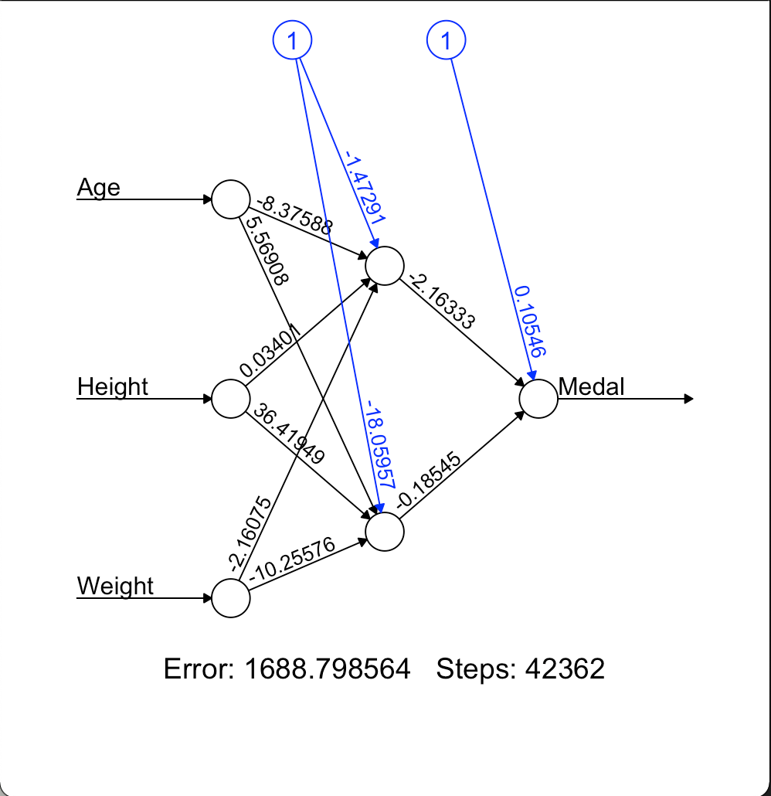
Create the neuralnet: #Neural Network model oly_nn <- neuralnet(Medal ~ Age + Height + Weight, data = training_data, hidden = 2, err.fct = "sse", linear.output = FALSE) plot(oly_nn, rep = "best")
Constants(Bias Weights)
Want to determine probabilities of different medals based on the 3 variables:
Weights
The neural net inputs are Age, Height, and Weight(X variables)
They are fed into 1 hidden layer with 2 nodes which allow for a bit more specificity without too much of a time tradeoff
Output is Medal(Y variable)

Slide 17
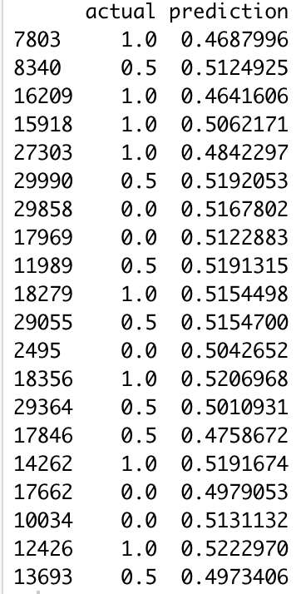
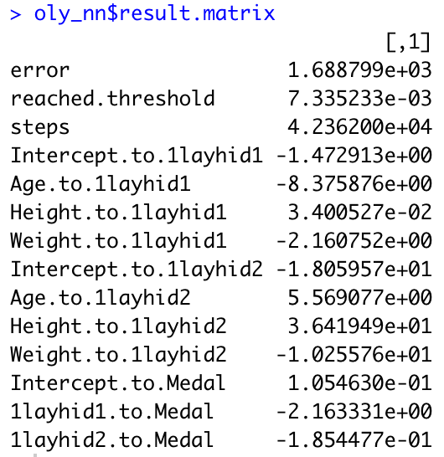
Neural Net Output:
Key: Gold = 0.0, Silver 0.5, Bronze = 1.0
3 values within the Y variable makes model efficacy difficult. You can no longer round which increases the potential for misclassification.
Neural nets take a lot of time to train.
Going forward we would drill down to a more specific segment and would want a more robust dataset for the inputs.

